Slide 1


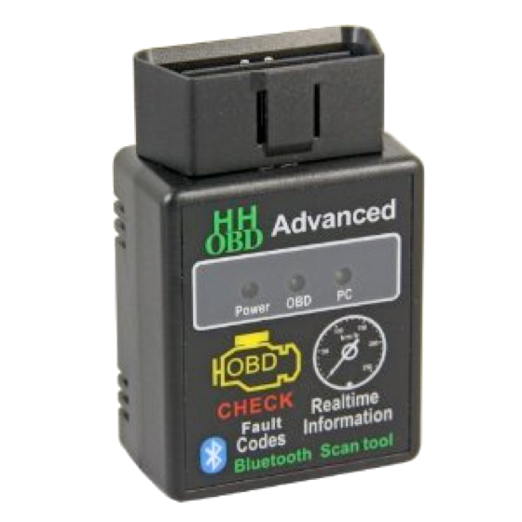
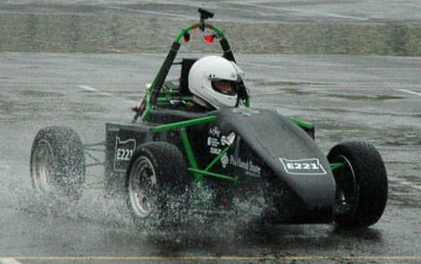
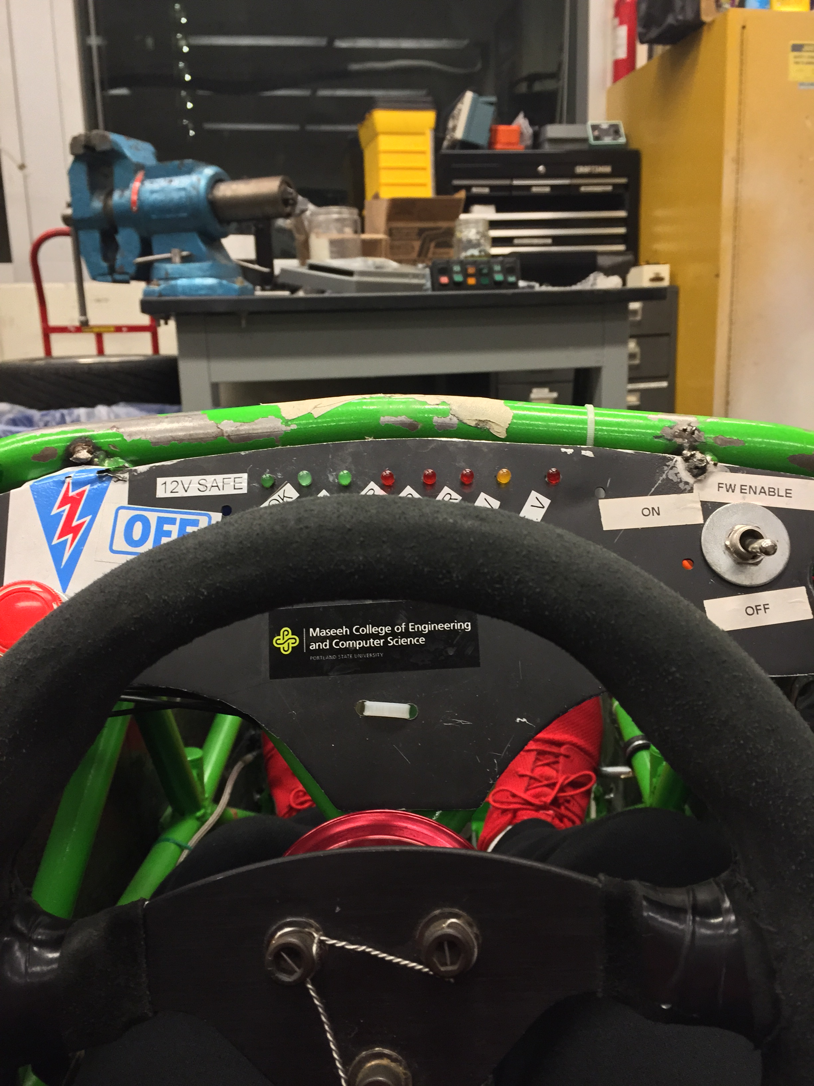
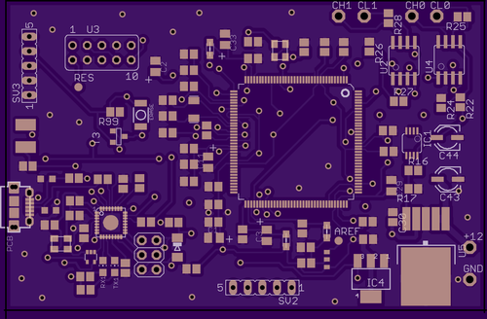
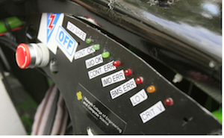
Digital Dash for SAE Electric Race Car
Capstone Team: Noah Erickson, Chad Thueson, Rishal Dass, Jaime Rodriguez, Sean Koppenhafer
Project Sponsor: Michal Podhrasky – Viking Motorsports Team
Capstone Advisor: Dr. Christof Teuscher – Portland State University ECE Department
Prior Work
Implementation
Performance
In the realm of racing each car is designed completely different based on several factors not limited to driver preferences, resources available and technical limitations. A few popular choices for digital dashboards currently exist. The popular Haltech Racepak is not only expensive, but requires the use of Haltech’s standalone ECU to source the data for the dash. Another setup would be a bluetooth adaptor plugged in to an OBDII port on board the car, but would’ve required the use of the OBDII protocol throughout the design of the car.
CAN Transceivers
Microprocessor
Screen
Oh yeah, it performs.
Picture of whole unit here
Hardware
Motivation
The real estate that the digital dash unit took up on the physical dash needed to be minimal. This requirement dictated two large design choices:
The 3.5” Display Size
The custom PCB to cut down size
The increased complexity that high voltage systems introduce onto a racecar require increased diagnostics to keep the car running safely. The Viking Motorsports team had previously used a simple bank of LEDs to indicate problems with mission critical systems. Troubleshooting these problems required the car to be off the track and logged data to be analyzed. With the addition of a digital dash system that reads data in real time from the vehicle control unit the driver could be kept up to date on system functionality either on track or in the pit stop.
Further Improvements
The digital dash could be implemented on the internal combustion car
Screen size could be maximized to fit the vehicles dash
The mainboard could be reprinted with the changes made, this would cut down on mod wires, cut traces and test connections
An improved power supply could be implemented to cut down on power consumption and compatability with a 12V system.
The enclosure could incorporate a cowl in order to improve readability in direct sunlight
The entire system was first prototyped using an Arduino Due which was slightly too large for the solution we had in mind.
Picture of LCD screen on Car goes here!!
The screen was slightly smaller than the LCD and the Arduino Due would have a lot of wires plugging into the screen. We wanted our device to be as plug-and-play as possible so we created a custom PCB that would plug directly into the LCD with no “mod wires”.
Software
Conclusions
Solution
The software portion of the digital dash was created using the Arduino IDE. In order to interface with the CAN bus and the 4D systems screen the use of two separate Arduino libraries were used. The software sniffs the CAN bus looking for pertinent CAN messages and scales them to their correct values and sends the data to the screen.
When it comes to implementing a digital dashboard on a Formula SAE racecar there are three major concerns. The first two concerns are solved by choosing a microprocessor, which was one of the first items we decided on. The microprocessor that drives the digital dashboard must support multiple communications protocols, in this case CAN and serial, and must be fast enough to handle receiving messages on a CAN bus. The 32bit 84MHz ATSAM3X microprocessor, the same microprocessor the Arduino Due uses, fit the bill perfectly with out of the box CAN capability. In addition to the microprocessors fast speeds and CAN capability, the design team could use an Arduino Due as an early prototyping platform while simultaneously designing a custom circuit board to house the ATSAM3X. Another large decision was the screen used since needed to have a high resolution while having a compact size. The high resolution is necessary to draw gauges, icons and bars all on the screen at once while the compact size is required by the layout of the vehicles frame.
This is objectively the best
digital dash ever created
Screen
The 4D Systems screen came with a useful piece of software to aide the quick creation of GUIs. The screen receives values from the mainboard through a serial connection. The GUI was created to be simple and intuitive. The designed GUI also utilizes the resistive touch capability of the screen in order to flip through a couple different submenus that include further information that a driver might want.
Acknowledgements
Special thanks to Quinn Sullivan for being the guy

